Slide 1






Project no. BS-SE-20-49
Lior Reznik
Under the supervision of Dr. Natalia Vanetik
The idea
build an automatic intrinsic evaluation system of English summaries
Problem Definition
Solution
Problem
A fully automatic intrinsic Deep learning model to score a summary!
Today in the era of information, information is everywhere. We are overwhelmed by it, in this era,
we can get every single piece of information from the internet: we can find books, articles, news.
But how can we obtain all this information, how can we get only the essential pieces from a given text?
We can summarize it! But! How can we know that the summary is an excellent fit for the text?
How can we know that we can rely on a summary?
Data
Time waits for nobody; We've got to build this world together:
We are trying to help!
Due the corona crisis, we have trained our model on covid-19 articles.

Slide 2
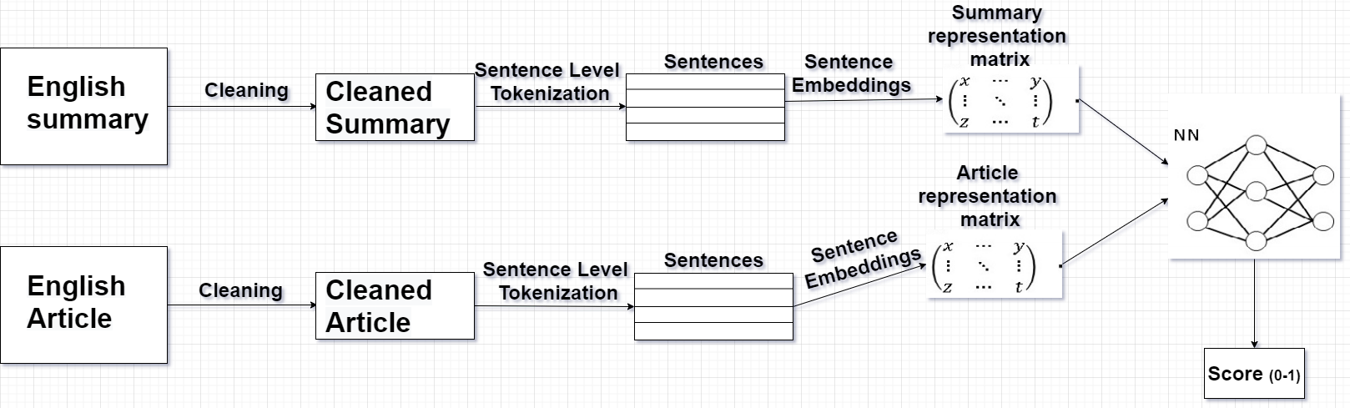
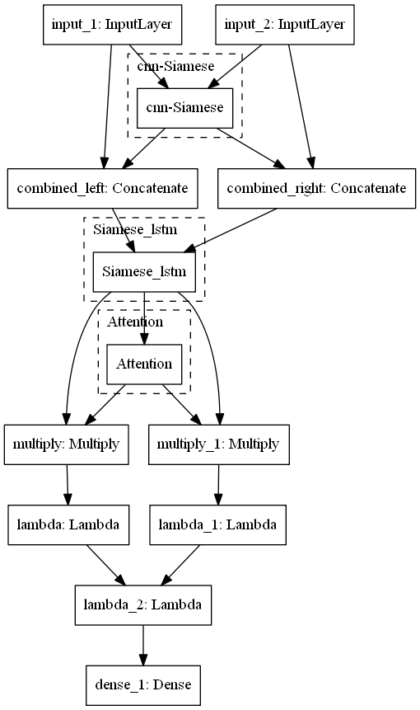
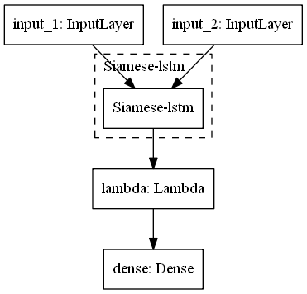
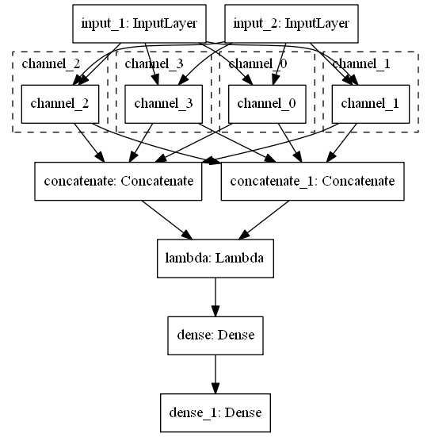
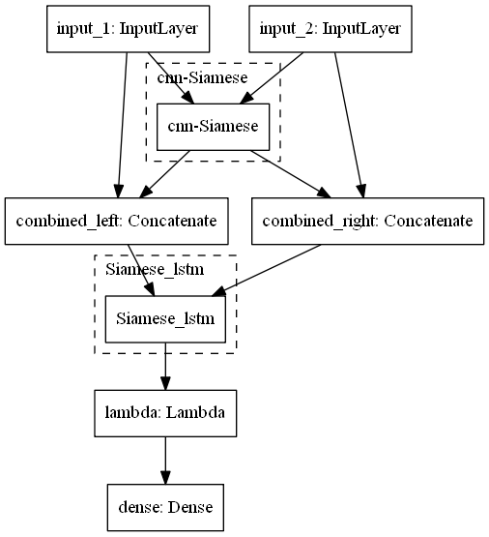
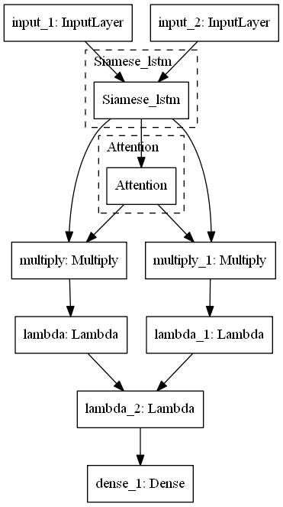
Project no. BS-SE-20-49
Lior Reznik
Under the supervision of Dr. Natalia Vanetik
Pipeline
Our architecture and main experiments
All of the experiments are based on Siamese networks, the basic idea behind these networks is to learn the same mapping function for the
two inputs. As such the input of the summary passed to the same architecture that the article passed in.
Consolations and future ideas
The best model gave the MSE score:0.0247 on dev,0.02095 on test(mean of chunks).
That Is not bad but! We can do better! The truth is that distance is a relative concept, I am closer to you then to my family at this moment,
but when I get home, I will be closer to my family.
So! We can feed the network with triplets of (article, good and bad summaries) and make it learn this relative concept.

